Slide 1
Math, Character and String Class
CSC103-Programming Fundamentals

Slide 2
Math Functions
Java provides many useful methods in the Math class for performing common mathematical functions.

Slide 3
The Math Class
Class constants:
PI
Class methods:
Trigonometric Methods
Exponent Methods
Rounding Methods
min, max, abs, and random Methods
E

Slide 4
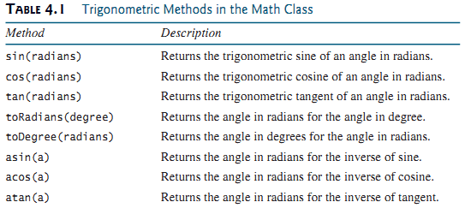
Trigonometric Methods

Slide 5
Trigonometric Methods
sin(double a)
cos(double a)
tan(double a)
acos(double a)
asin(double a)
atan(double a)
Examples:
Math.sin(0) returns 0.0
Math.sin(Math.PI / 6) returns 0.5
Math.sin(Math.PI / 2) returns 1.0
Math.cos(0) returns 1.0
Math.cos(Math.PI / 6) returns 0.866
Math.cos(Math.PI / 2) returns 0
Radians
toRadians(90)

Slide 6
Exponent Methods
exp(double a)
Returns e raised to the power of a.
log(double a)
Returns the natural logarithm of a.
log10(double a)
Returns the 10-based logarithm of a.
pow(double a, double b)
Returns a raised to the power of b.
sqrt(double a)
Returns the square root of a.
Examples:
Math.exp(1) returns 2.71
Math.log(2.71) returns 1.0
Math.pow(2, 3) returns 8.0
Math.pow(3, 2) returns 9.0
Math.pow(3.5, 2.5) returns 22.91765
Math.sqrt(4) returns 2.0
Math.sqrt(10.5) returns 3.24

Slide 7
Rounding Methods
double ceil(double x):
x rounded up to its nearest integer. This integer is returned as a double value.
double floor(double x):
x is rounded down to its nearest integer. This integer is returned as a double value.
double rint(double x):
x is rounded to its nearest integer. If x is equally close to two integers, the even one is returned as a double.
int round(float x):
Return (int) Math.floor(x+0.5).
long round(double x):
Return (long) Math.floor(x+0.5).

Slide 8
Rounding Methods Examples
// Math.ceil(double x) – Rounds UP
Math.ceil(2.3) → 3.0
Math.ceil(5.9) → 6.0
Math.ceil(-2.3) → -2.0
// Math.floor(double x) – Rounds DOWN
Math.floor(2.7) → 2.0
Math.floor(5.1) → 5.0
Math.floor(-2.3) → -3.0
// Math.rint(double x) – Rounds to nearest, tie goes to EVEN
Math.rint(2.3) → 2.0
Math.rint(2.7) → 3.0
Math.rint(2.5) → 2.0 // even
Math.rint(3.5) → 4.0 // even
// Math.round(float x) – Normal rounding (returns int)
Math.round(2.3f) → 2
Math.round(2.7f) → 3
Math.round(2.5f) → 3
// Math.round(double x) – Normal rounding (returns long)
Math.round(5.4) → 5
Math.round(5.5) → 6
Math.round(5.6) → 6

Slide 9
min, max, and abs
max(a, b)and min(a, b)
Returns the maximum or minimum of two parameters.
abs(a)
Returns the absolute value of the parameter.
random()
Returns a random double value in the range [0.0, 1.0).
Examples:
Math.max(2, 3) returns 3
Math.max(2.5, 3) returns 3.0
Math.min(2.5, 3.6) returns 2.5
Math.abs(-2) returns 2
Math.abs(-2.1) returns 2.1

Slide 10
The random Method
Generates a random double value greater than or equal to 0.0 and less than 1.0 (0 <= Math.random() < 1.0).
Examples:
In general,

Slide 11
Character Data Type
Computers use binary numbers internally
Mapping a character to its binary representation is called encoding
How characters are encoded is defined by an encoding scheme
Java supports Unicode (16 bit character encoding and 65,536 characters are possible)
A 16-bit Unicode takes two bytes
Preceded by \u, expressed in four hexadecimal digits
i.e. ranges from \u0000 To \uFFFF

Slide 12
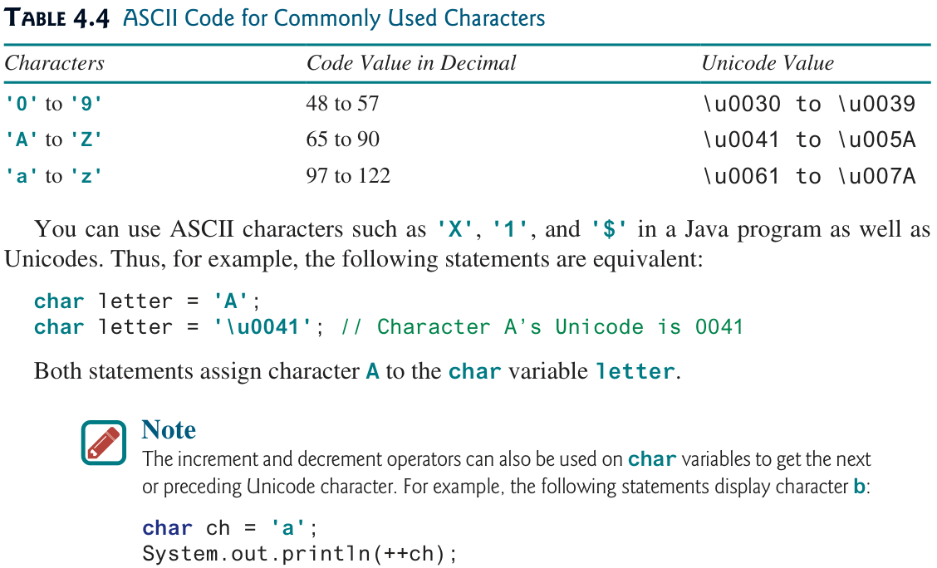
Unicode and ASCII Code

Slide 13
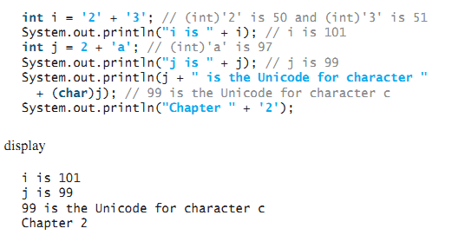
Casting between char and Numeric Types
int i = 'a'; // Same as int i = (int)'a';
char c = 97; // Same as char c = (char)97;
char ch = (char)65.25; // Decimal 65 is assigned to ch
System.out.println(ch); // ch is character A
All numeric operators can be applied to char operands

Slide 14
Comparing and Testing Characters
if (ch >= 'A' && ch <= 'Z')
System.out.println(ch + " is an uppercase letter");
else if (ch >= 'a' && ch <= 'z')
System.out.println(ch + " is a lowercase letter");
else if (ch >= '0' && ch <= '9')
System.out.println(ch + " is a numeric character");

Slide 15
Methods in the Character Class
char c = 'A';
System.out.println(Character.isDigit(c)); // false
System.out.println(Character.isLetter(c)); // true
System.out.println(Character.isLowerCase(c)); // false
System.out.println(Character.isUpperCase(c)); // true
System.out.println(Character.toLowerCase(c)); // ‘a’

Slide 16

String Type

Slide 17
The String Type
A string is a sequence of characters.
String is an object that represents sequence of char values.
The char type represents only one character
An array of characters works same as Java string
char[] ch={'j','a','v','a','t','p','o','i','n','t'}; String s = new String(ch);
String is a predefined class in the Java library(java.lang)
The String type is not a primitive type

Slide 18
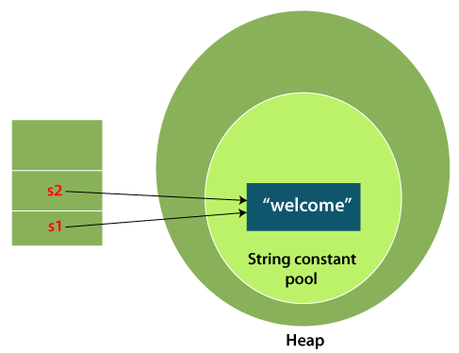
The String Type
Strings are objects in Java
There are two ways to create String object:
By string literal
String varName = “Some String”;
String s = "welcome";
JVM first checks the
String constant pool
If the string already exists in the pool, a reference to the pooled instance is returned
Otherwise, a new string instance is created and placed in the pool.
String s1 = "welcome";
String s2 = "welcome";

Slide 19
The String Type
There are two ways to create String object:
By new keyword
String varName = new String(“Some String”);
String s = new String(“welcome”);
JVM creates a new string object in normal heap memory
In above example variable s will refer to the object in a heap

Slide 20
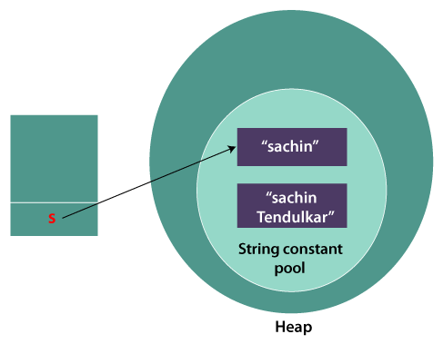
The String Type
Immutable String
In java String objects are immutable. Immutable simply means unmodifiable or unchangeable.
Example
String s=“Hello";
s.concat(" World");
System.out.println(s);
Hello
Hello World

Slide 21
Simple Methods for String Objects

Slide 22
Getting String Length
String message = "Welcome to Java";
System.out.println("The length of " + message + " is " + message.length());
The string appearing in program is called String literal
Such String literals are instances of String class
System.out.println(“Hello”.length());

Slide 23
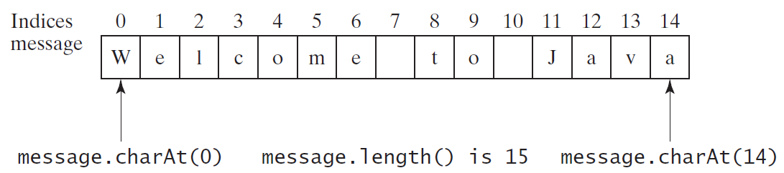
Getting Characters from a String
String message = "Welcome to Java";
System.out.println("The first character in message is " + message.charAt(0));

Slide 24
String Concatenation
String s3 = s1.concat(s2); or String s3 = s1 + s2;
// Three strings are concatenated
String message = "Welcome " + "to " + "Java";
// String Chapter is concatenated with number 2
String s = "Chapter" + 2; // s becomes Chapter2
// String Supplement is concatenated with character B
String s1 = "Supplement" + 'B'; // s1 becomes SupplementB
The augmented += operator can also be used for string concatenation
Example:
String message = “Welcome to Java”
message += “ and Java is fun” //output: Welcome to Java and Java is fun

Slide 25
String Concatenation
+ operator can also concatenate a number with a string in SOP function
In this case number is converted into the string and then concatenated.
If i = 1 and j = 2, what is the output of the following statement?
System.out.println("i + j is " + i + j);
Output: "i + j is 12"
System.out.println("1" + 1); //"1" + 1 → "11"
System.out.println('1' + 1); '1' has ASCII (Unicode) value = 49 49 + 1 → 50 System.out.println("1" + 1 + 1); 111
System.out.println("1" + (1 + 1));12
System.out.println('1' + 1 + 1); 49+1+! = 51

Slide 26
Converting Strings
"Welcome".toLowerCase() returns a new string, welcome.
"Welcome".toUpperCase() returns a new string, WELCOME.
" Welcome ".trim() returns a new string, Welcome. Which has no white spaces

Slide 27


Reading a String from the Console
Scanner input = new Scanner(System.in);
System.out.print("Enter three words separated by spaces: ");
String s1 = input.next();
String s2 = input.next();
String s3 = input.next();
System.out.println("s1 is " + s1);
System.out.println("s2 is " + s2);
System.out.println("s3 is " + s3);
The next() method reads a string that ends with a whitespace character
nextLine() method to read an entire line of text that ends with the ENTER key is pressed
Scanner input = new Scanner(System.in);
System.out.println("Enter a line: ");
String s = input.nextLine();
System.out.println("The line entered is " + s);

Slide 28
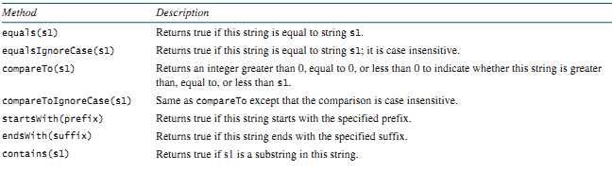
Comparing Strings

Slide 29
Comparing Strings
if (string1 == string2)
System.out.println("string1 and string2 are the same object");
else
System.out.println("string1 and string2 are different objects");
the == operator checks only whether string1 and string2 refer to the same object; it does not tell you whether they have the same contents.
equals(s2): The equals method returns true if two strings are equal and false if they are not.
String s1 = "Welcome to Java";
String s2 = "Welcome to Java";
String s3 = "Welcome to C++";
System.out.println(s1.equals(s2)); // true
System.out.println(s1.equals(s3)); // false

Slide 30
Comparing Strings
compareTo(s1)
The method returns the value 0 if s1 is equal to s2, a value less than 0 if s1 is less than s2, and a value greater than 0 if s1 is greater than s2.
String s1 = "Welcome to Java";
String s2 = "Welcome to Java";
String s3 = "Welcome to C++";
System.out.println (s1.compareTo(s2)); // Both are equal->0
System.out.println (s1.compareTo(s3)); // s1 is greater than s3-> 7 ASCII of J=74 and C=67 (74-67)
System.out.println (s3.compareTo(s1)); // s3 less than s1 -> -7 ASCII of J=74 and C=67 (67-74)
"Welcome to Java".startsWith("We") returns true.
"Welcome to Java".startsWith("we") returns false.
"Welcome to Java".endsWith("va") returns true.
"Welcome to Java".endsWith("v") returns false.
"Welcome to Java".contains("to") returns true.
"Welcome to Java".contains("To") returns false.

Slide 31

Example
Scanner input = new Scanner(System.in);
// Prompt the user to enter two cities
System.out.print("Enter the first city: ");
String city1 = input.nextLine();
System.out.print("Enter the second city: ");
String city2 = input.nextLine();
if (city1.compareTo(city2) < 0)
System.out.println("The cities in alphabetical order are " +city1 + " " + city2);
else
System.out.println("The cities in alphabetical order are " +city2 + " " + city1);

Slide 32

Obtaining Substrings
substring(beginIndex)
Returns this string’s substring that begins with the character at the specified beginIndex and extends to the end of the string
substring(beginIndex,endIndex)
Returns this string’s substring that begins at the specified beginIndex and extends to the character at index endIndex – 1. Note that the character at endIndex is not part of the substring.
String message = "Welcome to Java";
System.out.println(message.substring(3)); //come to Java
System.out.println(message.substring(11,message.length())); //Java

Slide 33
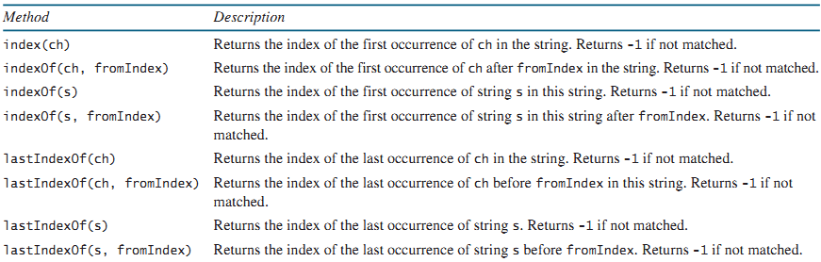
Finding a Character or a Substring in a String

Slide 34
Finding a Character or a Substring in a String
indexOf()
"Welcome to Java".indexOf('W') returns 0.
"Welcome to Java".indexOf('o') returns 4.
"Welcome to Java".indexOf('o', 5) returns 9.
"Welcome to Java".indexOf("come") returns 3.
"Welcome to Java".indexOf("Java", 5) returns 11.
"Welcome to Java".indexOf("java", 5) returns -1.
lastIndexOf()
"Welcome to Java".lastIndexOf('W') returns 0.
"Welcome to Java".lastIndexOf('o') returns 9.
"Welcome to Java".lastIndexOf('o', 5) returns 4.
"Welcome to Java".lastIndexOf("come") returns 3.
"Welcome to Java".lastIndexOf("Java", 5) returns -1.
"Welcome to Java".lastIndexOf("Java") returns 11.

Slide 35
Conversion between Strings and Numbers
To convert a string into an int value, use the Integer.parseInt method
int intValue = Integer.parseInt(intString);
where intString is a numeric string such as "123“
To convert a string into a double value, use the Double.parseDouble method
double doubleValue = Double.parseDouble(doubleString);
where doubleString is a numeric string such as "123.45"

